Slide 1

Planning

Slide 2

It bridges the gap between where we are and where we want to go.
PLANNING
Planning is an intellectual process of thinking restored to decide a course of action which helps to achieve the pre determined objectives of the organization in future

Slide 3
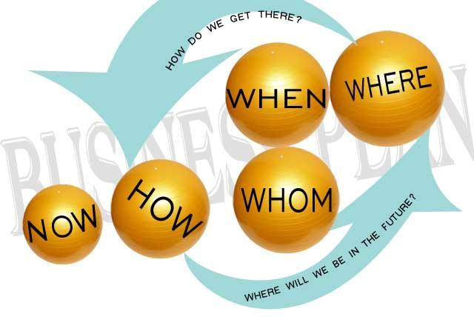
DEFINITION
Planning is deciding in advance what to do, how to do it, when to do it, and who to do it. It bridges the gap from where we are to , where we want to go.
- KOONTZ AND O’DONNEL

Slide 4
IMPORTANCE OF PLANNING
Planning Provides direction
Reduces uncertainty
Minimizes waste
Promotes creativity
Facilitates decision-making
Establishes standards for control

Slide 5
BENEFITS OF PLANNING
Improves organizational effectiveness
Encourages innovation
Helps in resource allocation
Enhances coordination between departments
Improves adaptability to change

Slide 6
PROCESS OF PLANNING
Set Objectives
Developing Planning Premises
Identifying Alternative courses of Action
Evaluating Alternative Courses
Selecting Alternative
Implementing Plan
Follow-up Action

Slide 7
CASE STUDY
A shoe manufacturing company wants to become a market leader. For this a detailed planning is required. The first step taken by the firm is to set targets for the three months duration for selling maximum number of shoes in the market which they set as 2, 50,000. The team doesn’t want to make any mistake so they decide to do proper planning. They decide to chalk out alternative plans so that they can arrive at the best possible plan. However, the team is surrounded with doubts. To remove doubts, it goes for judging the plans to get the most profitable one. The plan is taken to the whole organisation and the concerned persons. Ultimately it is put into action. Without much caring for the results the company starts working on the other project simultaneously. Identify the steps in the planning process which have been applied by the organisation in the above case?

Slide 8
SOLUTION
Setting Objectives: The first step taken by the firm is to set targets for the three months duration for selling maximum number of shoes in the market which they set as 2, 50,000
Identifying alternative courses of action: They decide to chalk out alternative plans so that they can arrive at the best possible plan.
Evaluating the different courses of action: To remove doubts it goes for selecting the plan which can be considered as the most profitable.
Selection of the best plan: The best plan is finalized.
Implementation of the plan: Ultimately it is put into action.

Slide 9
Types of Plans
Strategic Plan
Vision
Mission
Long-term goals
Tactical Plan
Department-level goals
Resource allocation
Implementing strategy
Operational Plan
Daily schedules
Standard operating procedures
Work assignments
Quality checks

Slide 10
Planning Tools and Techniques
Forecasting
Budgeting
Break-Even Analysis (BEA)
Gantt Chart
PERT (Program Evaluation and Review Technique)
SWOT Analysis
Decision Trees
MBO (Management by Objectives)
Gap Analysis

Slide 11
Organising
Organising is the management function of arranging people, work and resources in a structured way so that organisational goals can be achieved efficiently.
It means deciding who will do what work, who will report to whom and how different jobs will be coordinated.
Koontz & O’Donnell: Organising is the process of establishing relationships among members of the enterprise by assigning duties and authority.

Slide 12
Features of Organising
Division of work
Departmentation
Assignment of duties
Authority-Responsibility
Hierarchy of Authority
Coordination

Slide 13
Organisation Structure
Organizational structure is the backbone of any company’s operating procedures and workflows. It determines each employee’s place and role in the business and is key to organizational development.

Slide 14
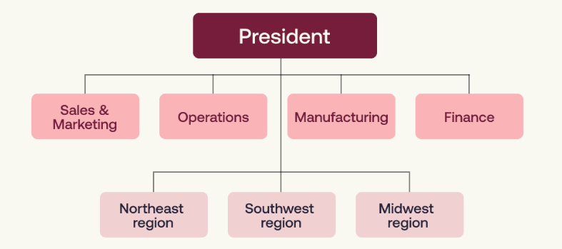
Centralized Organizational Structure

Slide 15
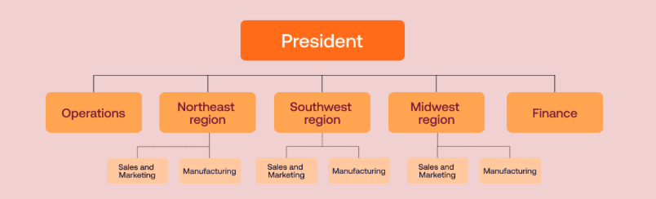
Decentralized Organizational Structure

Slide 16
Types of Organisation Structure
Functional structure
Divisional structure
Matrix structure
Team structure
Line structure
Flat organization structure

Slide 17
Functional Structure
CEO
Marketing
HR
Finance
Production
A functional organizational structure is one on which the tasks, people and technologies necessary to do the work of the business are divided into separate “functional” groups (such as Marketing, HR and Finance)

Slide 18
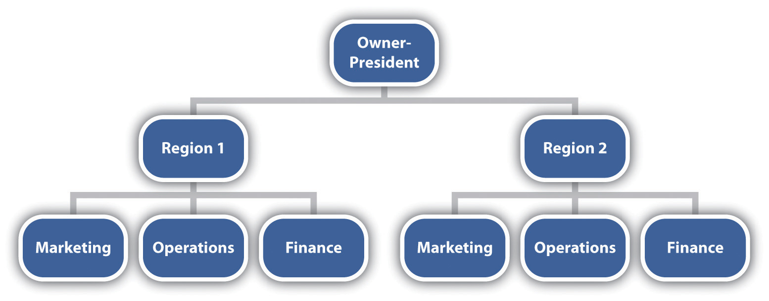
Divisional Structure
When a company expands to supply goods or services to a variety of customers, offers a variety of different products or are engaged in business in several different market, the company could adopt a divisional organisational structure.

Slide 19
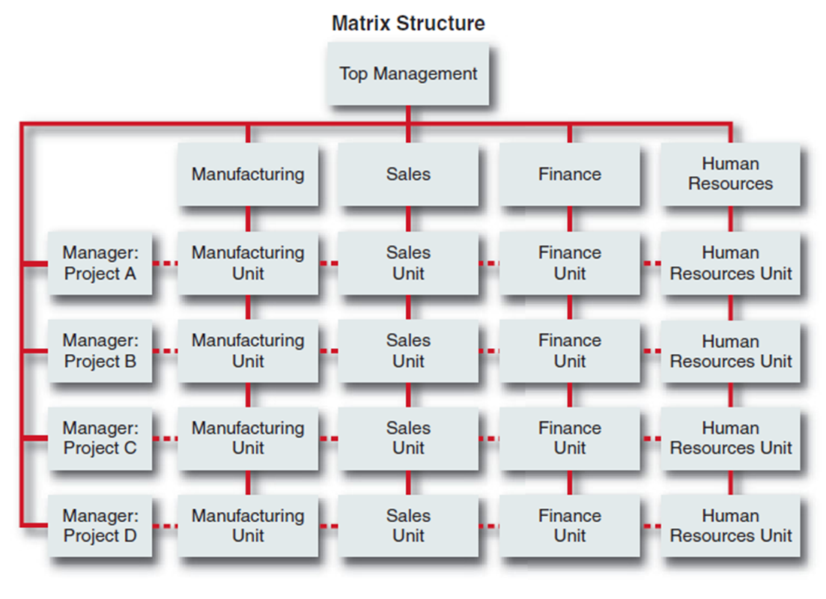
Matrix structure
Matrix design is one of the latest types of organisational designs which have been developed to establish flexible structure to achieve a series of project objectives.
Within a matrix organizational structure, team members report to several managers at once

Slide 20

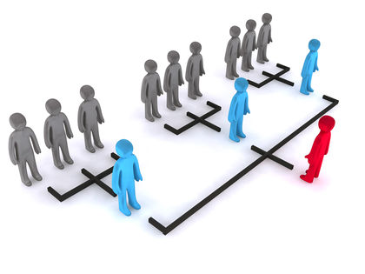
Team structure
Strategies of business are not always fixed. They go on changing depending upon internal and external environmental factors. Hence, a single type of organizational structure is not suitable for all times and all situations.

Slide 21
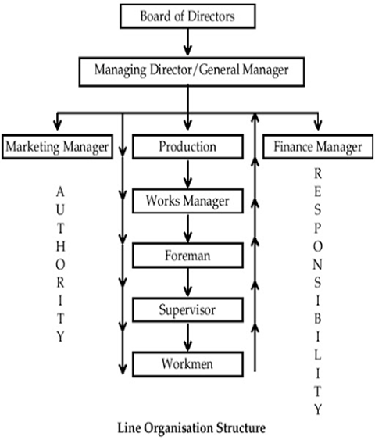
Line Structure
A hierarchical structure is the most common type of organizational structure. This pyramid-shaped structure follows a direct chain of command from the top and flows down the organisation chart through individual teams and entry-level employees.

Slide 22
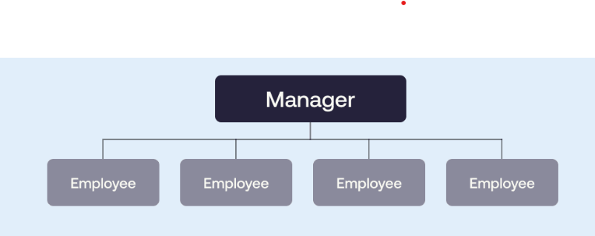
Flat Organization Structure
A flat organization is a structure with few or no layers of middle management, allowing for direct communication between employees and top leadership. Organizations often start with a flat structure and then transition to a different type of organizational structure late in their maturity.

Slide 23
Traditional Structures

Slide 24
Directions in Organisation Structures.
Vertical direction
Horizontal direction
Diagonal (cross-functional) direction
Centralisation vs Decentralisation

Slide 25
Leading
Leading is one of the core functions of management (along with Planning, Organising, Staffing and Controlling).
Leading refers to the process of influencing, motivating, and guiding employees to work actively towards achieving organisational goals.
Leadership is the ability to influence a group toward the achievement of goals.

Slide 26
Key Elements of Leading
Influence
Motivation
Communication
Guidance and supervision

Slide 27
Nature of Leading
Continuous Process
Involves Influence
Goal-Oriented
Interpersonal Process
Dynamic and Situational

Slide 28
Traits/Qualities of Leadership
Trait theory suggests that leaders possess certain inborn or acquired qualities that make them effective.
Some of the leaders in the history have always been identified as strong leaders based on the qualities that they display. Leaders like Mahatma Gandhi, Indira Gandhi, Nelson Mandela, Narayana Murthy of Infosys etc. has been identified, based on the traits that they displayed.
The trait theories of leadership consider personal qualities and characteristics that differentiate leaders from non-leaders (Robbins, Judge, & Sanghi, 2007).

Slide 29
In the beginning, the assumption behind trait theory was leaders are born and not made. This concept was popularly known as the “Great Man Theory” of leadership.
The great man theory was originally proposed by Thomas Carlyle in 1949 and the assumption behind this theory is that “Great leaders will arise, when there is great need”. The theory also assumes that a leader cannot be a normal person and they are different from the average person in terms of personality traits such as intelligence, perseverance and ambition.

Slide 30
Traits/Qualities of Leadership
Integrity
Intelligence
Extraversion
Meticulous
Open to Experience
Self-esteem

Slide 31
Behavioural Theories of Leadership
In the 1940s, apart from the research studies being conducted on the traits displayed by leaders, research was also conducted on the behaviours exhibited by leaders. The first and foremost study on leadership was carried out by psychologist, Kurt Lewin and his associates in 1939 and identified different styles of leadership, Autocratic, Democratic and Laissez-faire leadership.

Slide 32
Behavioural Theories of Leadership
While the assumption behind traits theory is that “leaders are born, rather than made”, behavioural theories assume that specific behavioural patterns of leaders can be acquired through learning and experience. While the trait theory concentrates on “what the leaders are”, the behavioural theories concentrate on “what the leaders do”.

Slide 33
Behavioural Theories of Leadership
Task-oriented leader behaviors involve structuring the roles of subordinates, providing them with instructions and behaving in ways that will increase the performance of the group. Task-oriented behaviors are directives given to employees to get things done and to ensure that organizational goals are met

Slide 34
Behavioural Theories of Leadership
People-oriented leader behaviors include showing concern for employee feelings and treating employees with respect. People-oriented leaders genuinely care about the well-being of their employees and they demonstrate their concern in their actions and decisions.

Slide 35
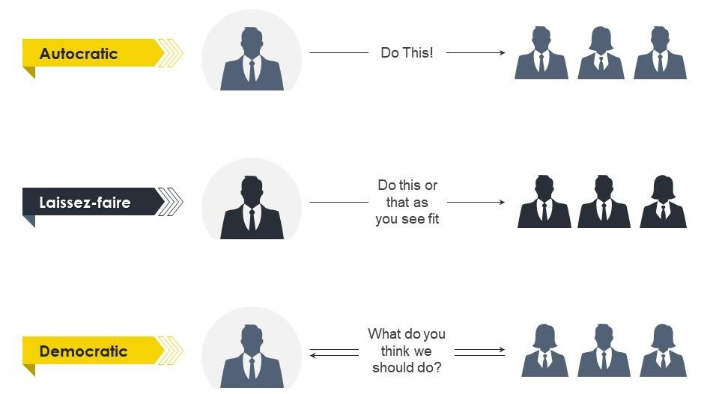
Leadership Styles Based on Authority

Slide 36
Contingency approaches to Leadership
Fiedler’s Contingency Theory
Situational Leadership
Path-Goal Theory of Leadership

Slide 37
Fiedler’s Contingency Theory
The earliest and one of the most influential contingency theories was developed by Frederick Fiedler. Fiedler, F. (1967). A theory of leadership effectiveness.
According to the theory, a leader’s style is measured by a scale called Least Preferred Coworker (LPC) scale.
They rate the person in terms of how friendly, nice and cooperative the person is.
According to Fiedler’s theory, different people can be effective in different situations.

Slide 38
The theory predicts that in “favorable” and “unfavorable” situations.
There are three conditions creating situational favorableness: (1) Leader-subordinate relations (2) Position power and (3) Task structure.

Slide 39
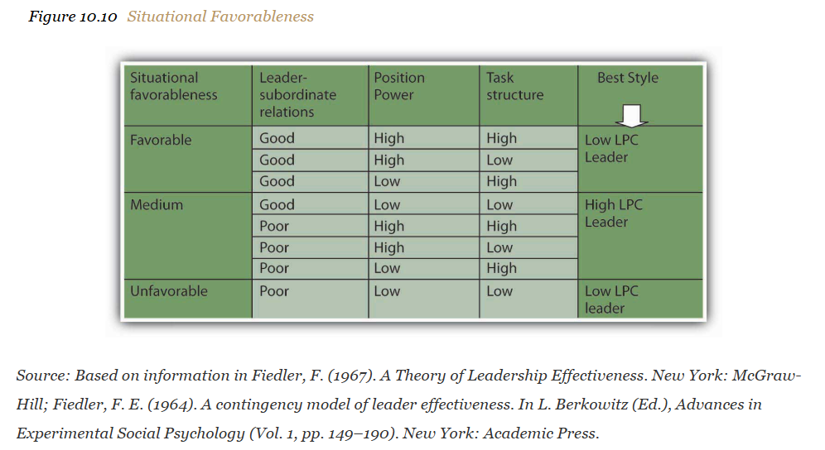

Slide 40
Situational Leadership
Another contingency approach to leadership is Kenneth Blanchard and Paul Hersey’s Situational Leadership Theory (SLT) which argues that leaders must use different leadership styles depending on their followers’ development level. Hersey, P.H., Blanchard, K.H., ' Johnson, D.E. (2007). Management of Organizational Behavior: Leadership human resources.
According to this model, employee readiness (defined as a combination of their competence and commitment levels) is the key factor determining the proper leadership style.

Slide 41
The model summarizes the level of directive and supportive behaviors that leaders may exhibit.
Leaders must use the right style of behaviors at the right time in each employee’s development.
It is recognized that followers are key to a leader’s success.
Supportive behaviors are recommended once the employee is at moderate to high levels of competence.

Slide 42
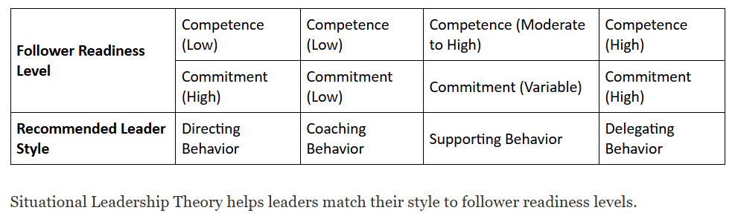

Slide 43
Path-Goal Theory of Leadership
Robert House’s path-goal theory of leadership is based on the expectancy theory of motivation. House, R. J. (1971). A path goal theory of leader effectiveness. Administrative Science Quarterly, 16(3), 321–338.
Expectancy theory of motivation suggests that employees are motivated when they believe or expect;
Their effort will lead to high performance
Their high performance will be rewarded
The rewards they will receive are valuable to them.

Slide 44
According to the path-goal theory of leadership, the leader’s main job is to make sure that all three of these conditions exist.
The theory also makes specific predictions about what type of leader behavior will be effective under which circumstances. House, R. J. (1996). Path-goal theory of leadership:
The theory identifies four leadership styles.
Directive leaders
Supportive leaders
Participative leaders
Achievement-oriented leaders

Slide 45
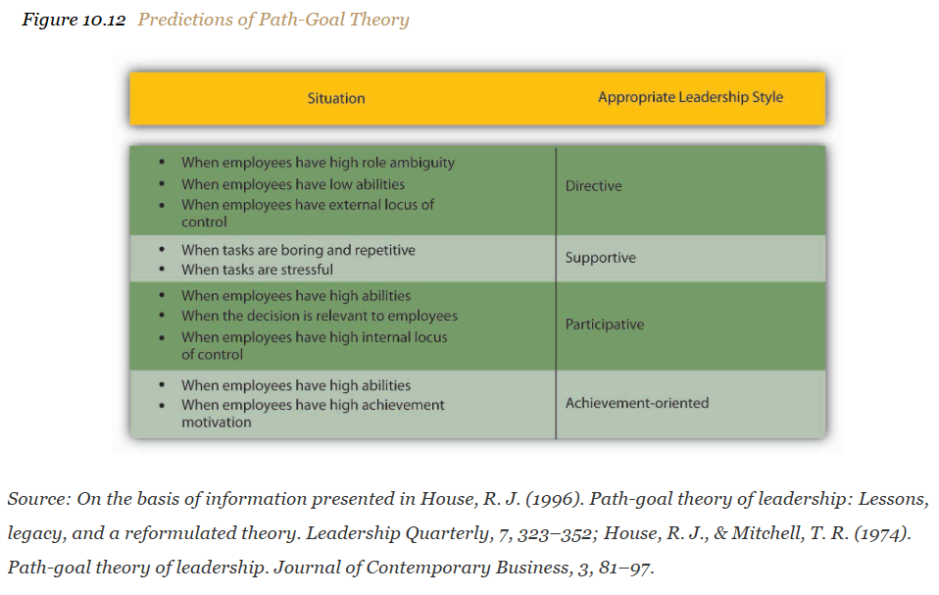

Slide 46
Transformational leadership
Transformational leaders lead employees by aligning employee goals with the leader’s goals. Thus, employees working for transformational leaders start focusing on the company’s well-being rather than on what is best for them as individual employees.
Transformational leaders use inspirational motivation or come up with a vision that is inspiring to others.

Slide 47
Transformational leaders have four tools in their possession, which they use to influence employees and create commitment to the company goals. Bass, B. M. (1985).
Key Components (4 I’s)
Idealised Influence: Leader acts as role model
Inspirational Motivation: Creates compelling vision
Intellectual Stimulation: Encourages innovation and creativity
Individualised Consideration: Personal attention to employees

